Slide 1

Bikeable cities
Rebecca Riso
Metis Project 2

Slide 2
Introduction
Motivation:
Bike-share company
Expanding internationally
Objectives:
Determine what makes a city ‘bikeable’
Predict ‘bikeability’ in a candidate city

Slide 3







Model Sources
Target: Bike score
0-100
Features:
Public transit score
Traffic congestion
Population & business density
Weather
Population
GDP per capita
Local taxes

Slide 4




Methodology
Models:
OLS
Techniques
Ridge & Lasso
Kfold CV
Metrics:
R²
Adjusted R²
MAE

Slide 5
Results
Model | R² | Adjusted R² | MAE
OLS | 0.251 | 0.217 | 7.331
Ridge | 0.261 | 0.227 | 7.217
Lasso | 0.256 | 0.222 | 7.213

Slide 6
Results
Feature | Coefficient
Constant | 0.00
Transit score | 3.44 (+)
Traffic index | 1.43 (+)
Population density (sqrt) | 0.68 (+)
Population (log) | 0.26 (+)
Average temperature | 0.63 (--)
Average precipitation | 1.18 (--)
Business density | 0.00
Local taxes | 0.00
GDP per capita | 0.00

Slide 7
Conclusions: What makes a city ‘bikeable’
Candidate cities:
Congested & densely populated
Precedent for alternative modes
Nice weather
(low precipitation, not too hot)

Slide 8
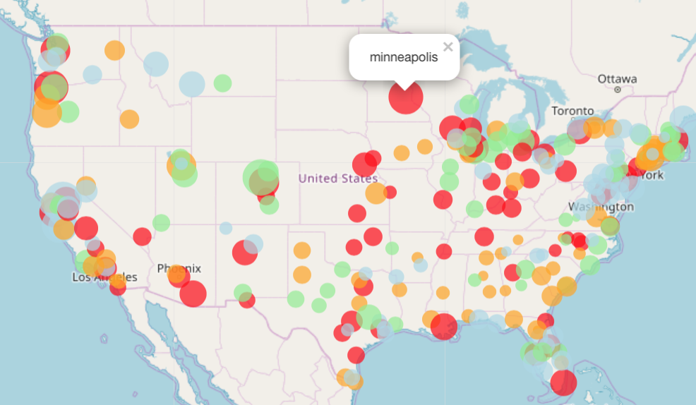
Conclusions: Predicting ‘bikeability’
Color | Traffic
 | High
 | Moderate
 | Fair
 | Low
Bike score

Slide 9
Future work
Additional features
Infrastructure
Hills
Adjust target
Business success of current cities
Classification
International application

Slide 10
Questions

Slide 11
Appendix (1)
Features | Correlations
Walk score + Transit score | 0.56
Business per square mile + Population density | 0.52
Population density + Transit score | 0.52
City tax + Total tax | 0.72
Transit score + Population density (sqrt) | 0.55

Slide 12
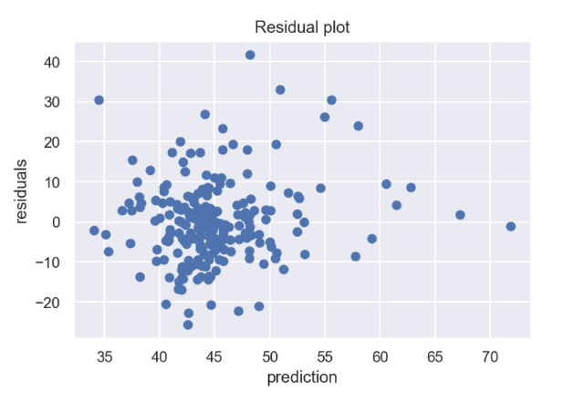
Appendix (2)

Slide 13
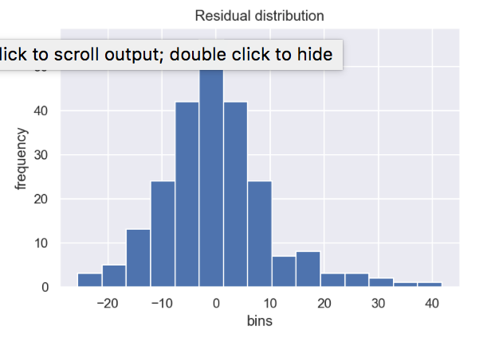
Appendix (3)

Slide 14
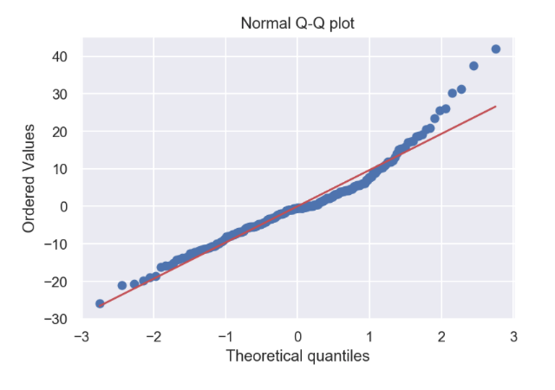
Appendix (4)

Slide 15
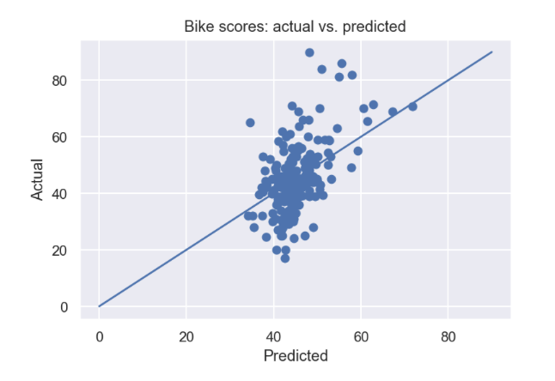
Appendix (5)

